Slide 1
ENGINEERING MATHEMATICS MINI PROJECT
PRESENTED BY
Mahesh kumar G
Janarthanan B
Janardhanan J
Karthikeyan S
MENTORS
DR.K.A.Selvakumaran
A.K.Arulmozhi

Slide 2
APPLICATION COMPLEX INTEGRATION

Slide 3
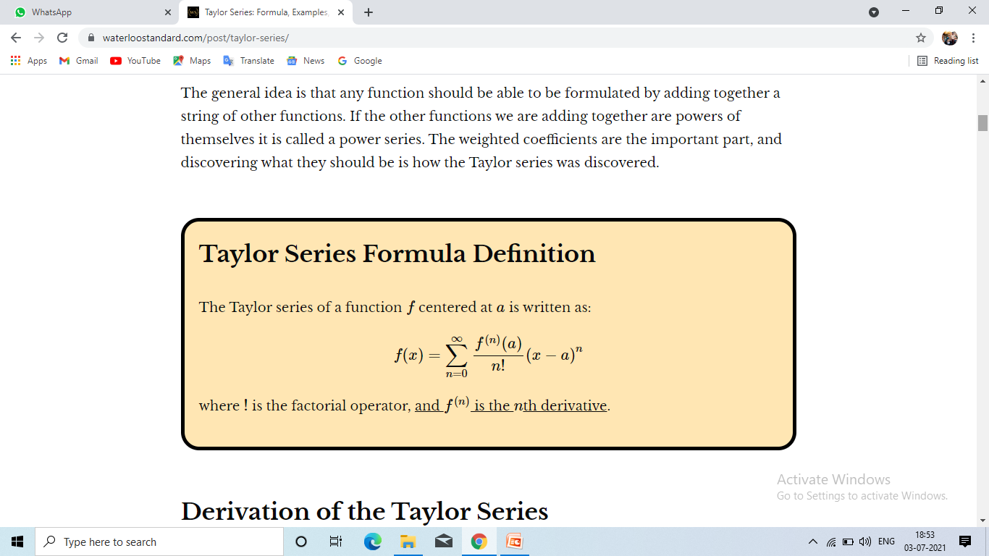
Taylor Series
Taylor series of a function is an infinite sum of terms that are expressed in terms of the function's derivatives at a single point. For most common functions, the function and the sum of its Taylor series are equal near this point. Taylor's series are named after Brook Taylor who introduced them in 1715.

Slide 4
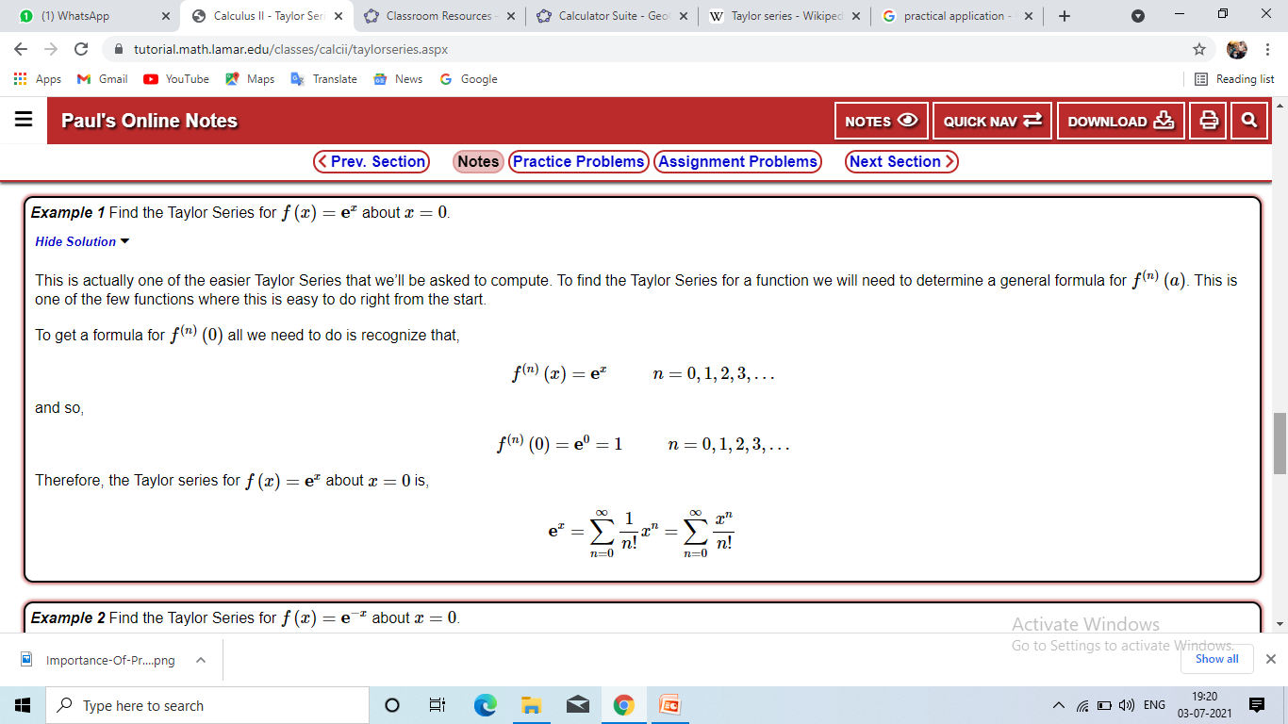

Slide 5

PRACTICAL APPLICATIONS OF TAYLOR SERIES
The Taylor series is used in power flow analysis of electrical power systems (Newton-Rapshon method ).
Multivariate Taylor series is used in different optimization techniques ; that is you approximate your function as a series of linear or quadratic forms , and then successively iterate on item to find .
Taylor series is used to find the sum of a series .
It is used to Evaluate limits .
It used to approximate functions .

Slide 6
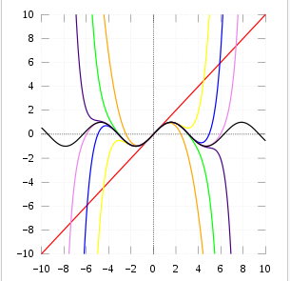
In a structural engineering , taylor series is used in the process to find the realiability index using the first order ,second moment , mean value realiability index .
differential equations are made easy with taylor series.
It is also used to calculate the value of an entire function at every point .

Slide 7
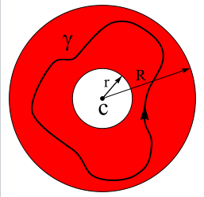
PRACTICAL APPLICATIONS OF LAURENT’S SERIES
Laurent series is used to describe the analytic function.
It allows us to work around the singularities of a complex function .
In mathematics ,the laurent series of a complex function f(z) is a representation of that function as a power series which includes terms of negative degree .it may be used to express complex functions in cases where a taylor series expansion cannot be applied .

Slide 8
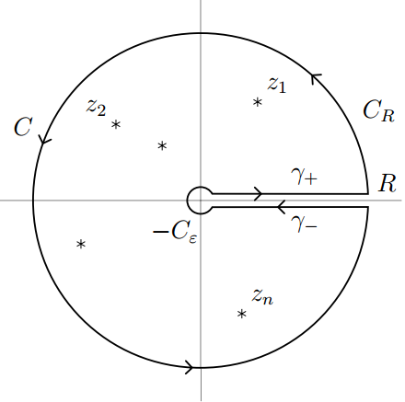
APPLICATIONS OF COMPLEX INTEGRAL
Integrals are extremely important in the study of functions of a complex variable mainly for two reason.
For instance , the existence of higher derivatives of analytic functions .
Secondly in applications real integrals occur which cannot be evaluated by usual methods , but can be evaluated by complex integration .

Slide 9
To Evaluate definite integrals
Obtaining asymptotic solutions of differentials equations .
Many physical quantities that were originally real become complex as simple theory is made from general .

Slide 10
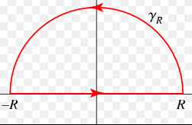
COUNTOUR INTEGRATION
Contour integration is the process of calculating the values of a contour integral around a given contour in the complex plane . As a result of a truly amazing property of holomorphic functions , such integrals can be computed easily simply by summing the values of the complex residues inside the contour .

Slide 11
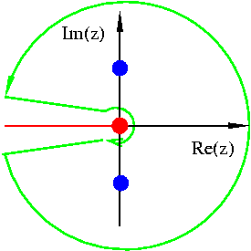
APPLICATIONS OF CONTOUR INTEGRATION
Contour integration appears in entropy and is the backbone of residue theory that , in turn , finds many well-known applications . They are
To evaluate some improper integrals
To evaluate a Fortiori
To calculate Fourier
To calculate Laplace and Z transforms
To evaluate the integrals along the real line .

Slide 12
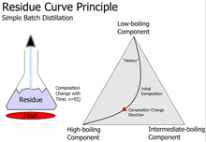
RESIDUE
In a mathematics, more speifically complex analysis , the residue is a complex number proportional to the contour integral of a meromorphic function along a path enclosing one of its singularties.(more generally , residues can be calculated for any function .

Slide 13
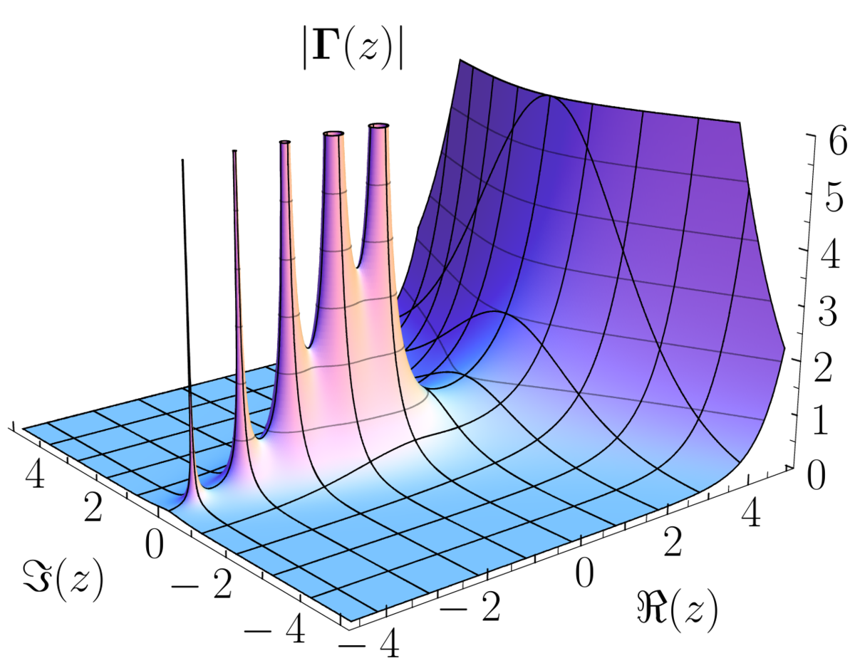
APPLICATIONS OF RESIDUES
Evaluation of definite and improper integrals occuring in real analysis and applied math .
Finding inverse Laplace transform by the methods of summing residues .
Functional Analysis
Linear Algebra
Analytic number theory
Quantum number theory
Algebraic geometry
Abelian integrals

Slide 14
Dynamical systems
It is a powerful tool to Evaluate line integrals of Analytic functions over closed curves .

Slide 15


